Slide 1
Group 10
Dental Hygiene Device
A tool for dentists and their patients
By: Simon Hume, Chris Sparrow, and Bora Bromberg

Slide 2
Problem + User Needs
Users are people of all ages, as we all need to brush our teeth
Applying toothpaste can be difficult for many as it requires dexterity and both hands
Parkinson's
Arthritis
Partial paralysis
Amputees
Unstable grip
The device will also act as a learning tool for young users
Our device will eliminate what can be a stressful or near impossible task for many people, helping users and their dentists
to maintain proper tooth brushing habits

Slide 3
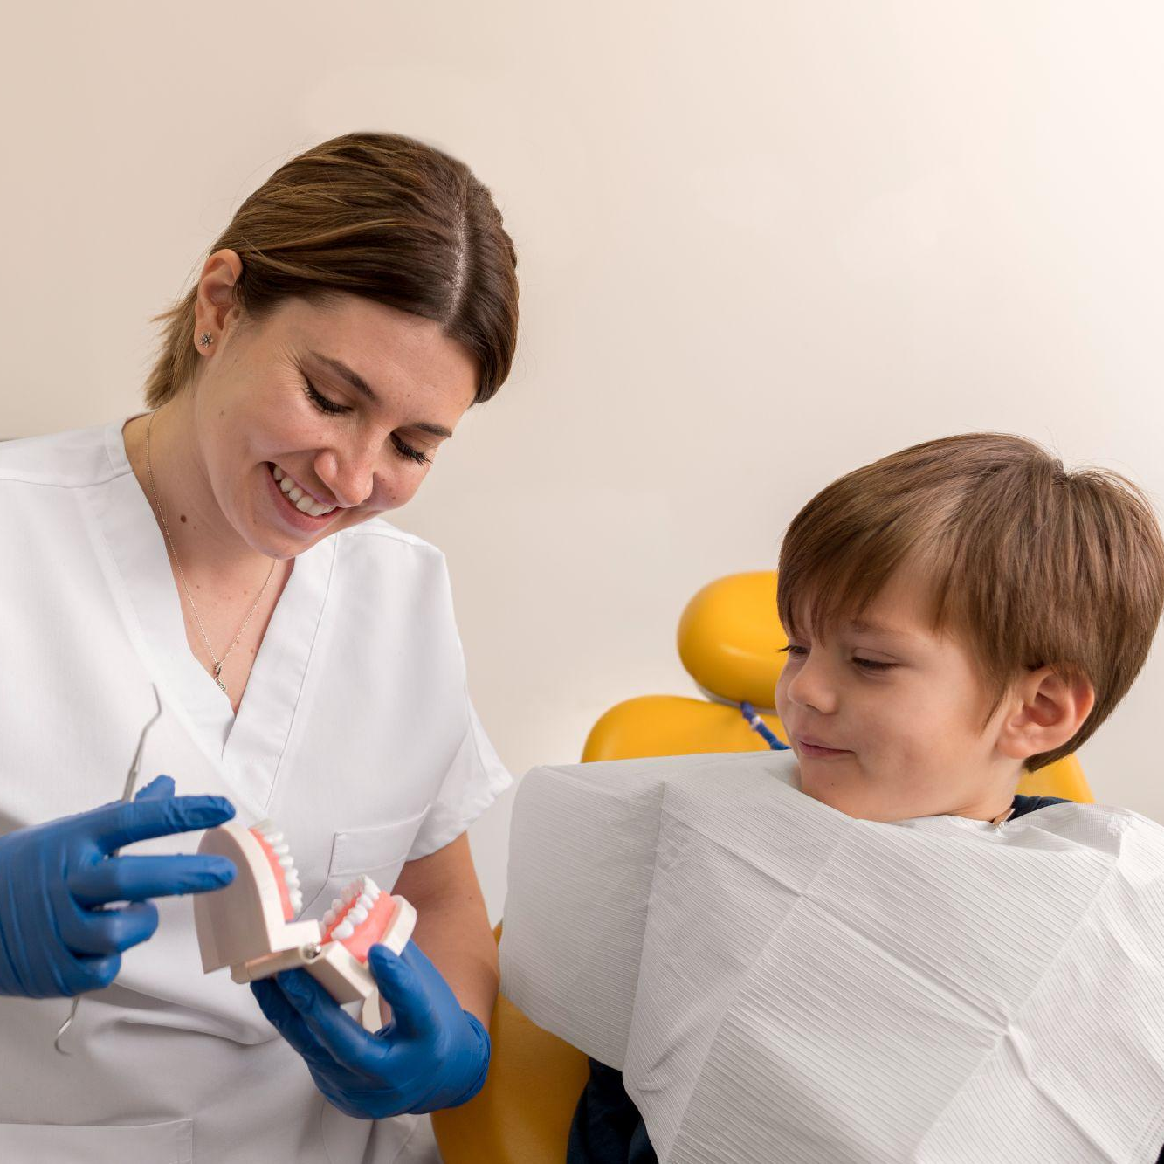
User Considerations
Our device only requires 1 hand to use
Simply, user centric design
Narrow insert space to accommodate shaking hands
Large instructions and arrows for visual aids
Cheap to produce

Slide 4
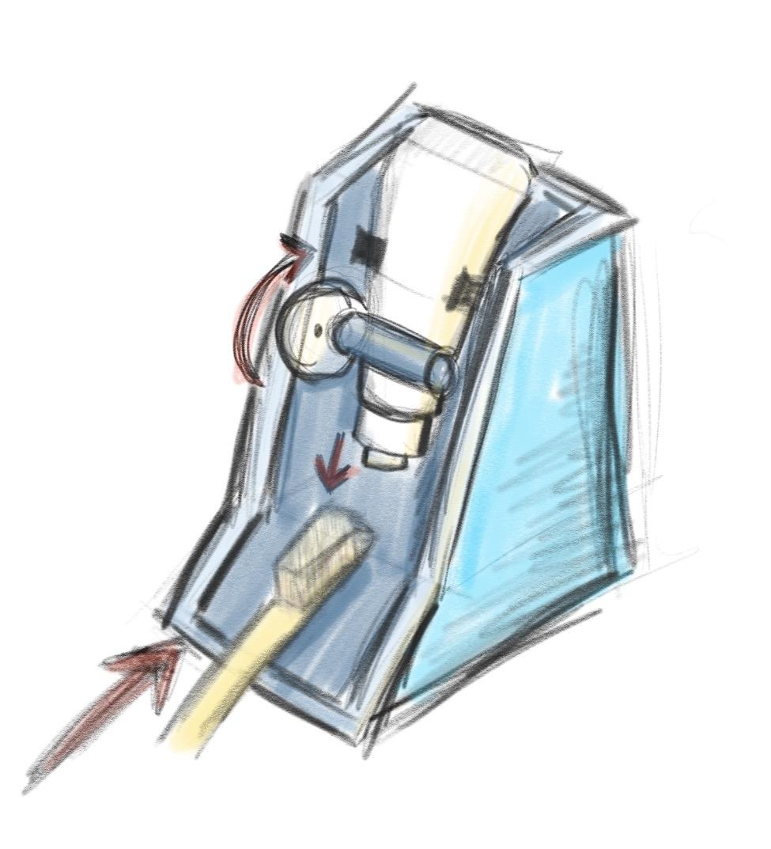
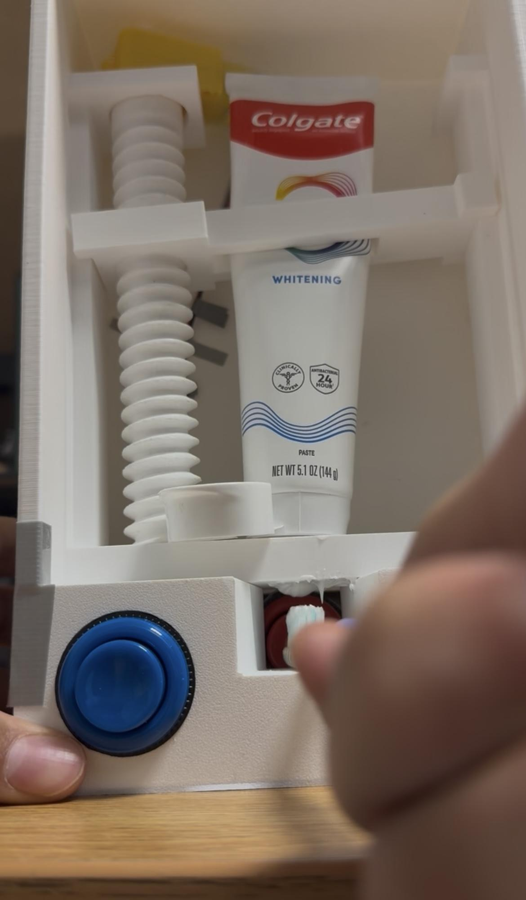
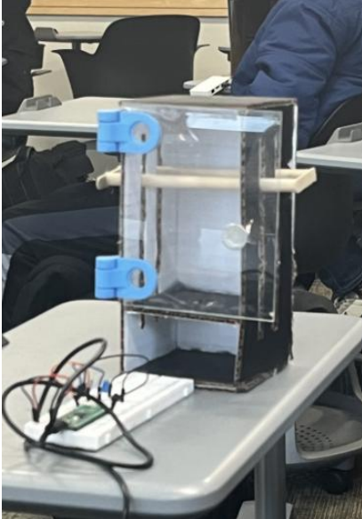
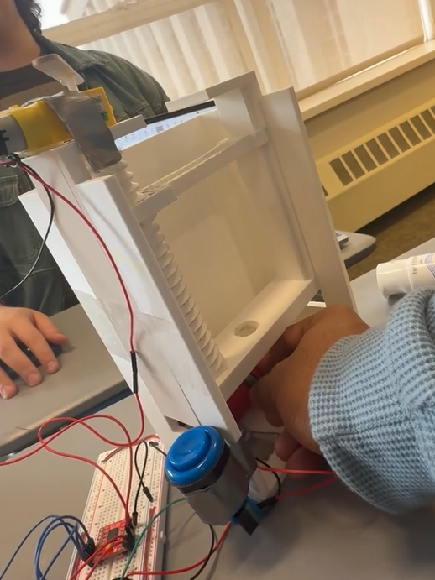
Design Process
Initial Sketch
First Printed Prototype
Second Prototype
Cardboard Prototype

Slide 5
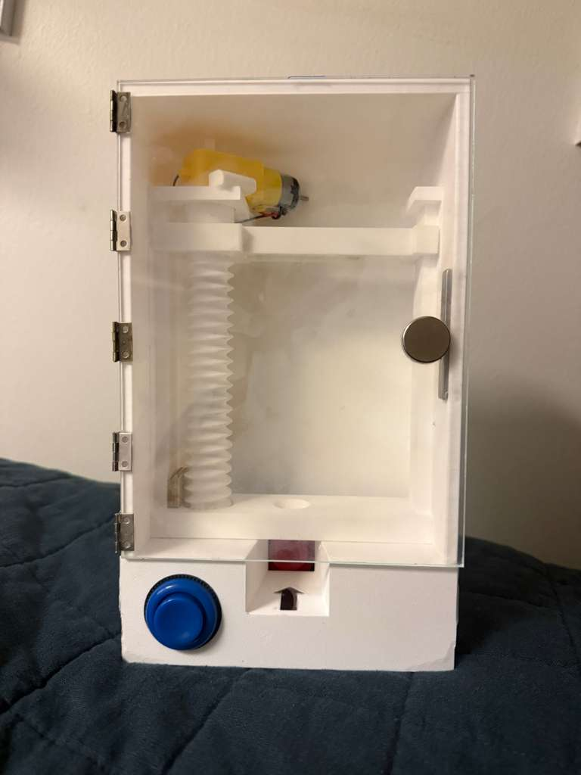
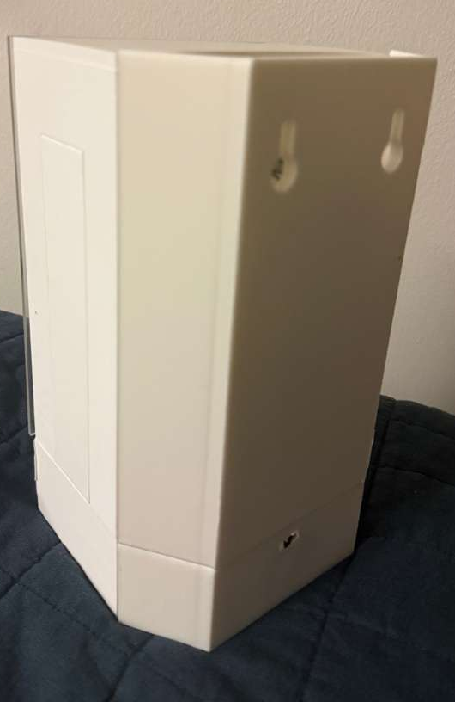
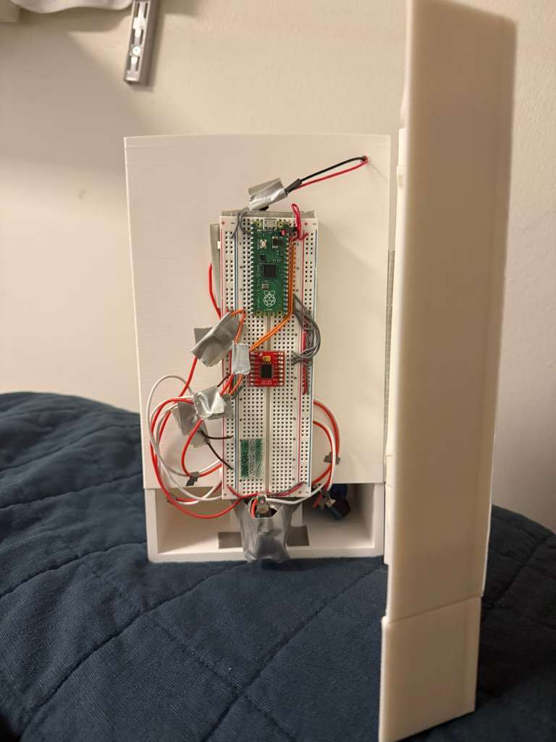
Final Design

Slide 6

Final Design Features
Sensory Feedback
See Through Door
Instructions
Ease of Use

Slide 7

Design Challenges
3D printed pieces required a great amount of sanding and physical alterations (prototype 1)
Greater tolerance added along with improvements to models (prototype 2)
Right-side end of arm would continue to catch on wall (prototype 2)
Made arm more rigid to axle with less surface area touching the wall (final version)
Because of the non-collaborative nature that we attacked our first milestone with, many problems occurred during the first integration of printed parts and Pico elements.
For following milestones, we emphasised clear team communication, preventing many possible errors before they became a large problem.

Slide 8
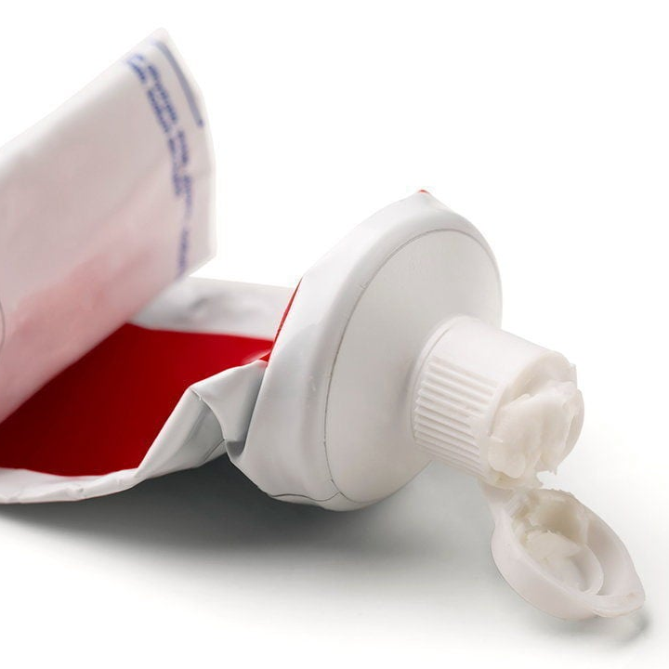
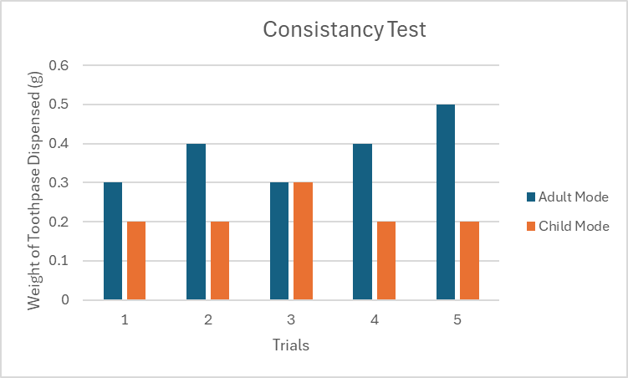
Analysis

Slide 9

Reflection
Teamwork
System Integration
Coordination

Slide 10
Bibliography
[1] American Dental Association, “Home Oral Care Recommendations to Reduce the Risk of Caries and Gum Disease,” Jul. 22, 2024. [Online]. Available: https://www.ada.org/-/media/project/ada-organization/ada/ada-org/files/resources/library/oral-health-topics/ada_home_oral_care_flyer_2024july22.pdf Accessed: Jan. 26, 2026.
[2] American Dental Association, “Toothbrushes,” Oct. 7, 2022. [Online]. Available: https://www.ada.org/resources/ada-library/oral-health-topics/toothbrushes. Accessed: Jan. 26, 2026.
[3] American Academy of Pediatric Dentistry, “Best Practices: Fluoride Therapy,” The Reference Manual of Pediatric Dentistry, 2025. [Online]. Available:https://www.aapd.org/media/Policies_Guidelines/BP_FluorideTherapy.pdf. Accessed: Jan. 26, 2026.
[4] Centers for Disease Control and Prevention, “About Dental Fluorosis,” May 15, 2024. [Online]. Available: https://www.cdc.gov/oral-health/about/about-dental-fluorosis.html. Accessed: Jan. 26, 2026.
[5] G. Thornton-Evans et al., “Use of Toothpaste and Toothbrushing Patterns Among Children and Adolescents — United States, 2013–2016,” MMWR Morb. Mortal. Wkly. Rep., vol. 68, no. 4, pp. 87–90, Feb. 1, 2019. [Online]. Available: https://www.cdc.gov/mmwr/volumes/68/wr/mm6804a3.htm. Accessed: Jan. 26, 2026.
This presentation template was designed by Slidesgo

